Slide 1
Look Up, Look Out
PART 2
Mark 13

Slide 2
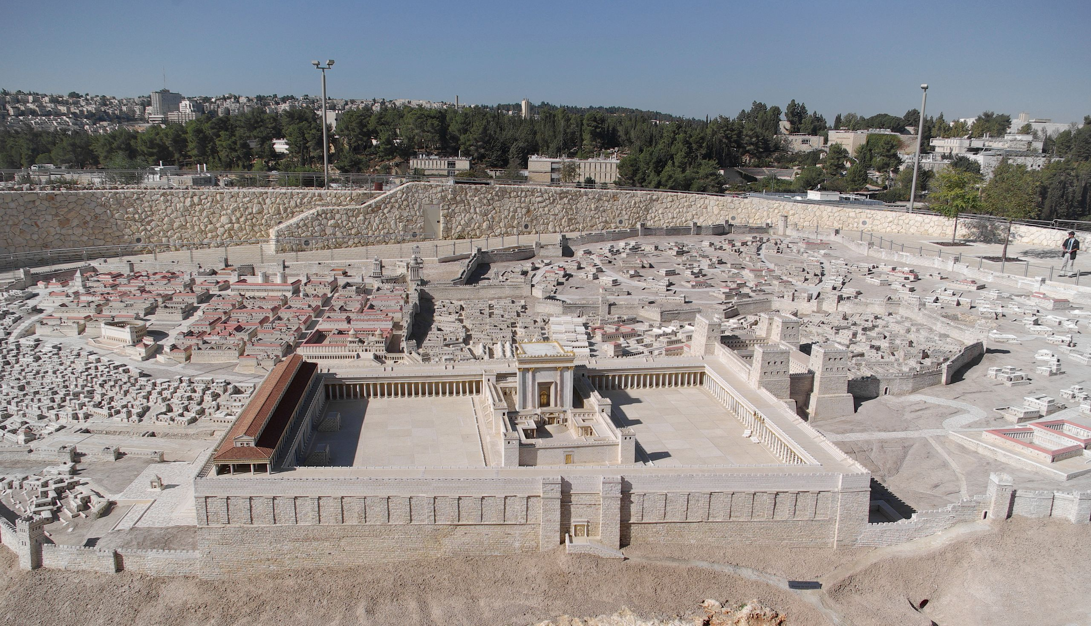

Slide 3
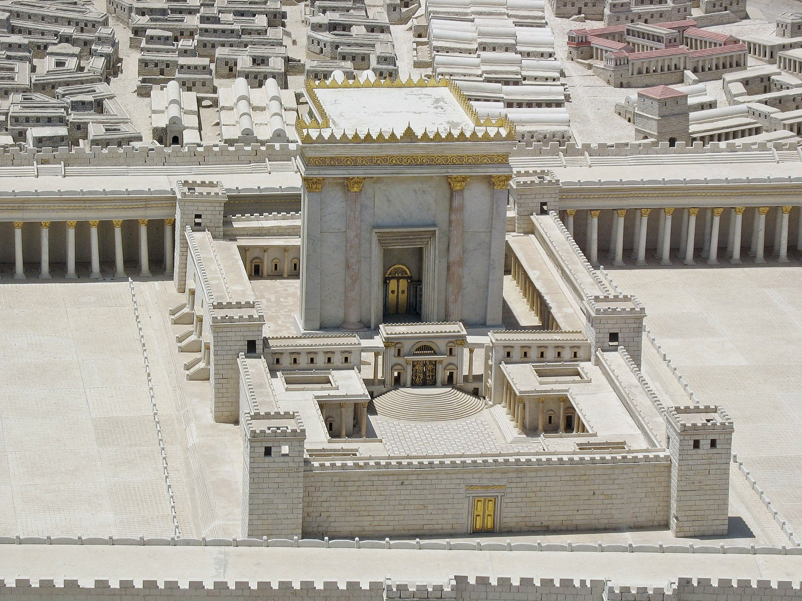

Slide 4
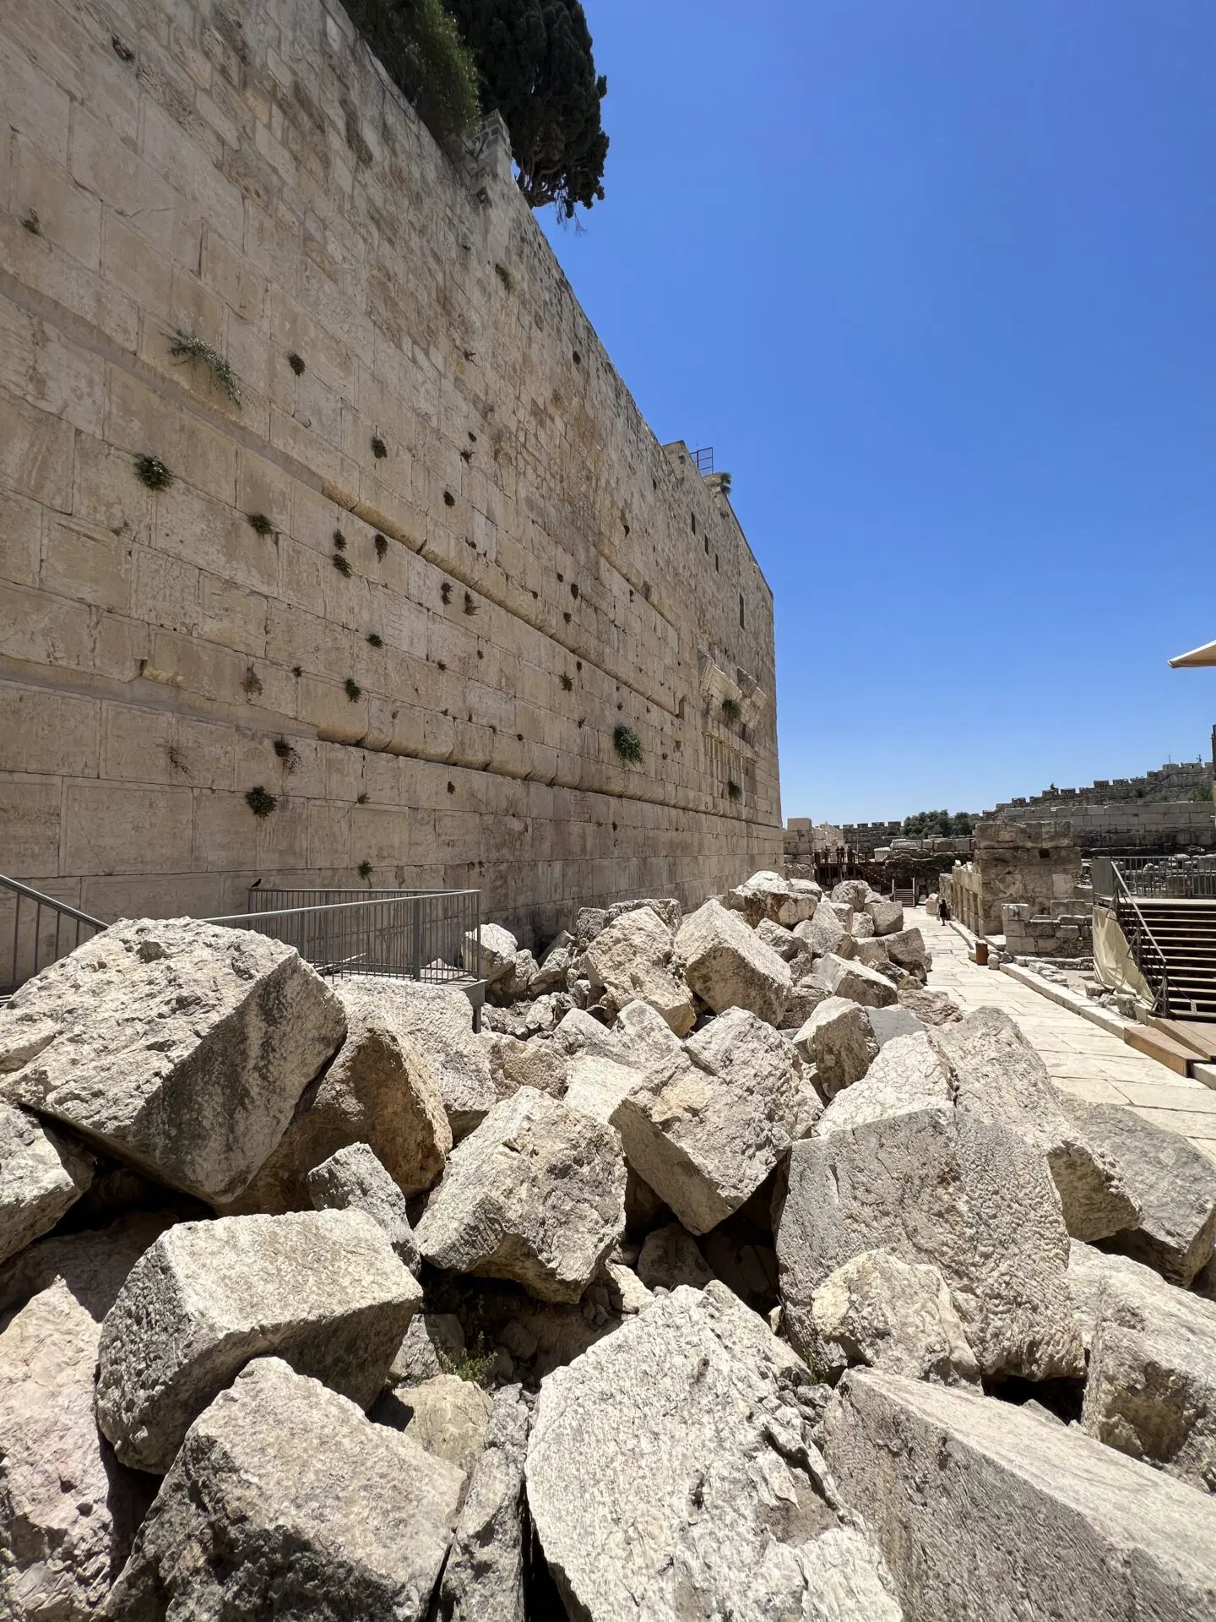

Slide 5
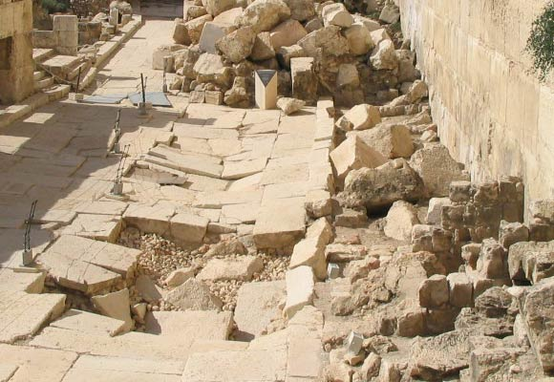

Slide 6
I. Jesus reveals the sign of his coming. (14a)
The sign will be in the middle of the Tribulation.

Slide 7
The Tribulation is a seven-year period before the Messiah comes to reign.
490 years were predicted for the Jews in Daniel 9:24-27
The period started in 445 BE (Neh. 2:5)
After 483 years, Messiah would be killed.

Slide 8
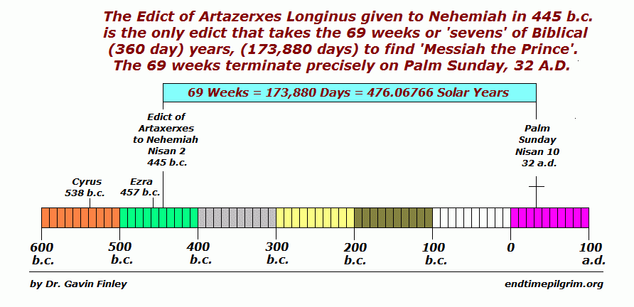

Slide 9
The Tribulation is a seven-year period before the Messiah comes to reign.
490 years were predicted for the Jews in Daniel 9:24-27
The period started in 445 BE (Neh. 2:5)
After 483 years, Messiah would be killed.
The remaining seven years are described in Dan 9:27.
There is a gap of time between the 483 and the 7 years.
The 7 years begins with a peace treaty (Dan. 9:26).
The treaty is broken after 3 ½ years (v9:7; 11:31)

Slide 10
I. Jesus reveals the sign of his coming. (14-a)
The sign will be in the middle of the Tribulation.
One prophecy may predict similar events across time.

Slide 12
I. Jesus reveals the sign of His coming. (14a)
The sign will be in the middle of the Tribulation.
One prophecy can predict similar events across time.
The sign is the Antichrist setting himself up as God.

Slide 13
What or who is the Antichrist?
the “prince to come” in Daniel 9
John uses the term in 1st & 2nd John

Slide 14
1st John 2:17
Children, it is the last hour; and just as you heard that antichrist is coming, even now many antichrists have appeared; from this we know that it is the last hour.

Slide 15
1st John 2:22
This is the antichrist, the one who denies the Father and the Son.

Slide 16
1st John 4:3
…and every spirit that does not confess Jesus is not from God; this is the spirit of the antichrist, of which you have heard that it is coming, and now it is already in the world.

Slide 17
2nd John 1:7
… those who do not acknowledge Jesus Christ as coming in the flesh. This is the deceiver and the antichrist.

Slide 18
What or who is the Antichrist?
the “prince to come” in Daniel 9
John uses the term in 1st and 2nd John
“one who opposes Christ”
“the Beast” in Revelation 13-14
He will seek to destroy Jews and any who don’t worship him (Dan. 9; Rev. 13)
He will set himself up as God in the temple (2 Thes. 2:1-12; Rev. 13)

Slide 19
II. God’s Word speaks to us today. (14b-18)
Be spiritually awake and watchful.
B. Prophecy is for today and tomorrow.

Slide 20
III. God’s Word is sufficient for what I face. (19-23)
God’s mercy is always greater.
B. The final test for truth is God’s Word.

Slide 21
Stay alert and stay on mission until the coming of Christ.
MAIN
IDEA

